Slide 1
TO SPREAD PURE WATER
Here we spread a pure and quality water to the customer by the help of a Genuine Owner.

Slide 2
FOCUS ON SERVE BETTER QUALITY
First of all we discuss about water. Water is a colorless and tasteless but it is played a very important role in our life and for alive and for circulation of earth water is necessary.
So we help that people drink healthy and purified water and save our some time of our life so we have launched a idea that people drink better water with affordable price by the help of our shopkeeper.

Slide 3
EXPLAIN ABOUT OUR IDEA
We are committed to promoting healthy hydration, which is why we are offering premium bottled water featuring customized labels for your brand. This is a high-impact, cost-effective tool for branding and advertising. By partnering with us, you can enhance your brand’s visibility and increase your profitability at an exceptionally reasonable price.

Slide 4
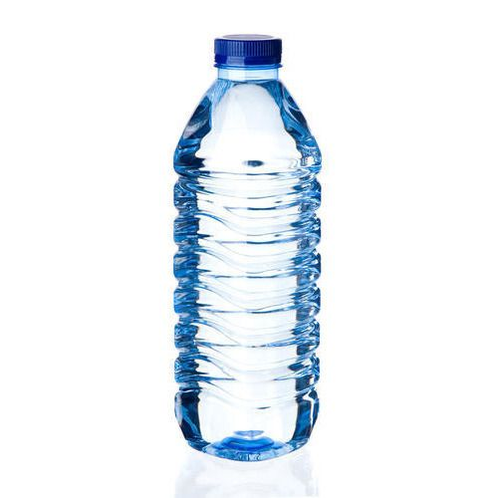
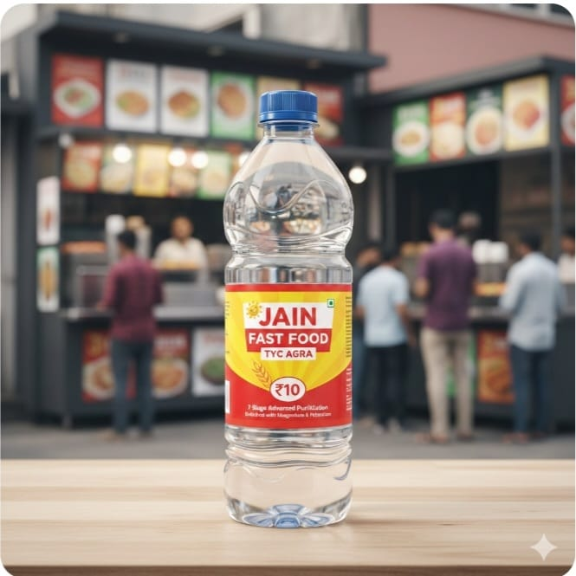
ABOUT PRODUCT
WATER BOTTLE
LIKE JAIN WATER BOTTLE

Slide 5
Thank You
SV Enterprises is a well-planned and professionally established business, committed to strengthening the market presence and brand value of your products.
We look forward to collaborating with you to grow and market your business successfully.
For Business Enquiries & Marketing Collaboration
Mr. Sandeep Agarwal
SV Enterprises
📞 Phone: 7017964418
✉️ Email: sandeepagarwalji1212@gmail.com

